Slide 1
How to make an amazing app with Cognitive Services
Yiğit Özaksüt
@ozaksuty
yigit@ozaksut.com
www.ozaksut.com

Slide 2
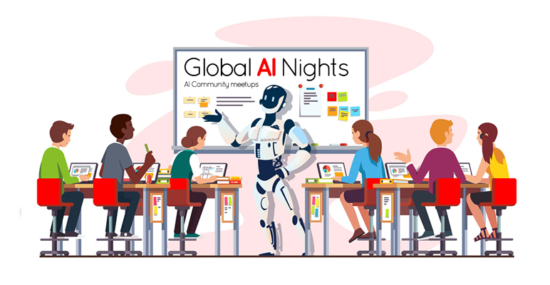
Azure Cognitive Services
can help me build Intelligent Applications
https://azure.microsoft.com/en-gb/services/cognitive-services/directory/

Slide 4
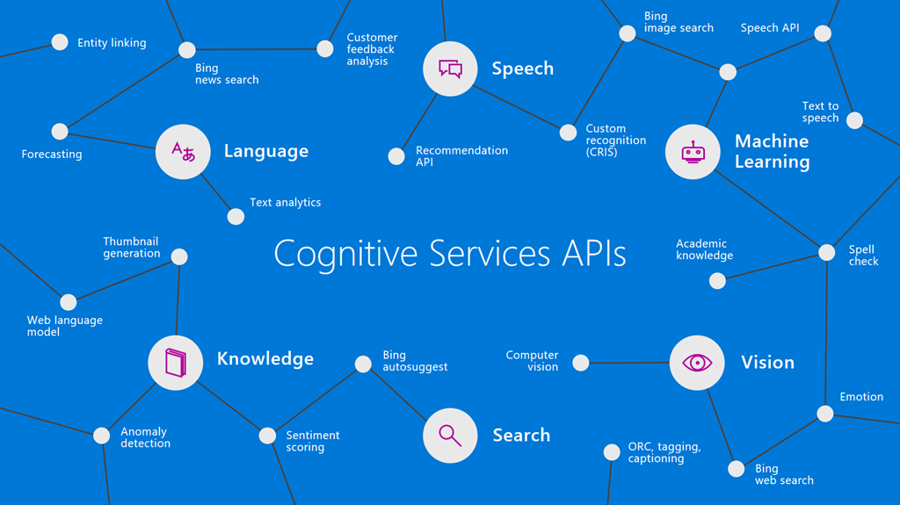
Use AI to solve business problems
Vision
Speech
Language
Decision
Search

Slide 5
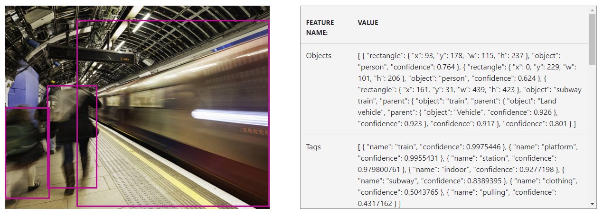
Try at home
Analyse an image

Slide 6
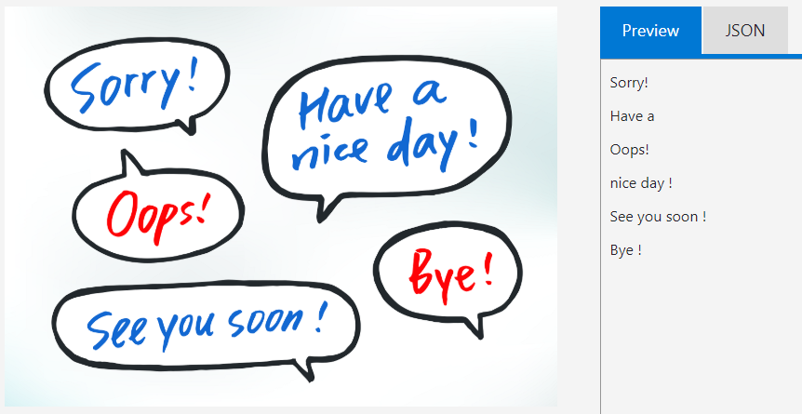
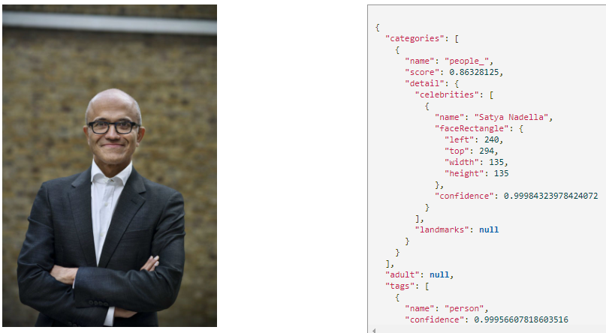
Try at home
Recognise brands, celebrities and landmarks
Read both printed and handwritten text in images
https://github.com/Teknolot/ai-bootcamp-2018-demo

Slide 7
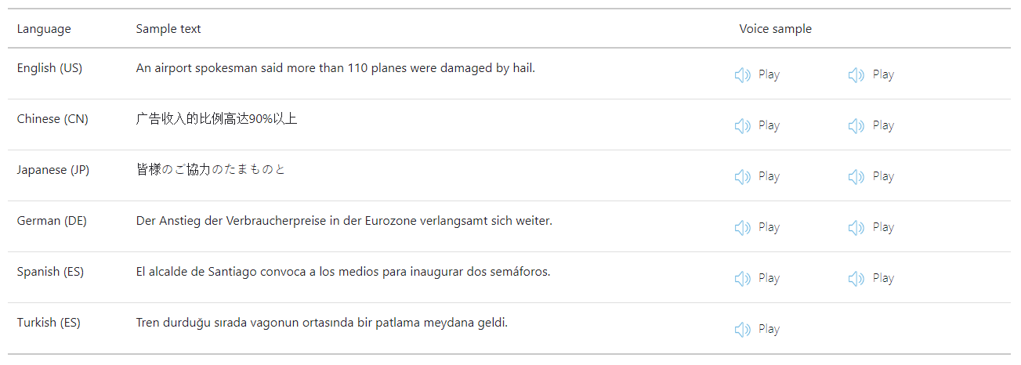
Try at home
Standard Text to Speech in action

Slide 8
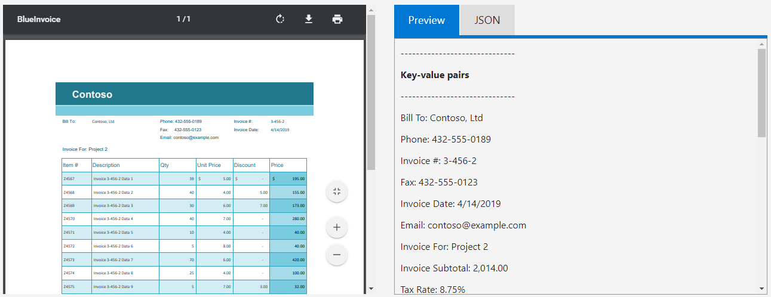
Try at home
Easily extract text and structure with simple REST API

Slide 9
Try at home
Extract information from your text

Slide 10
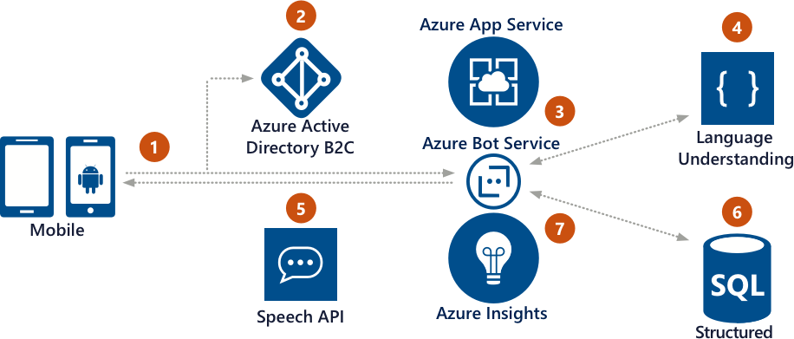
Give your bot intelligence with Cognitive Services

Slide 11
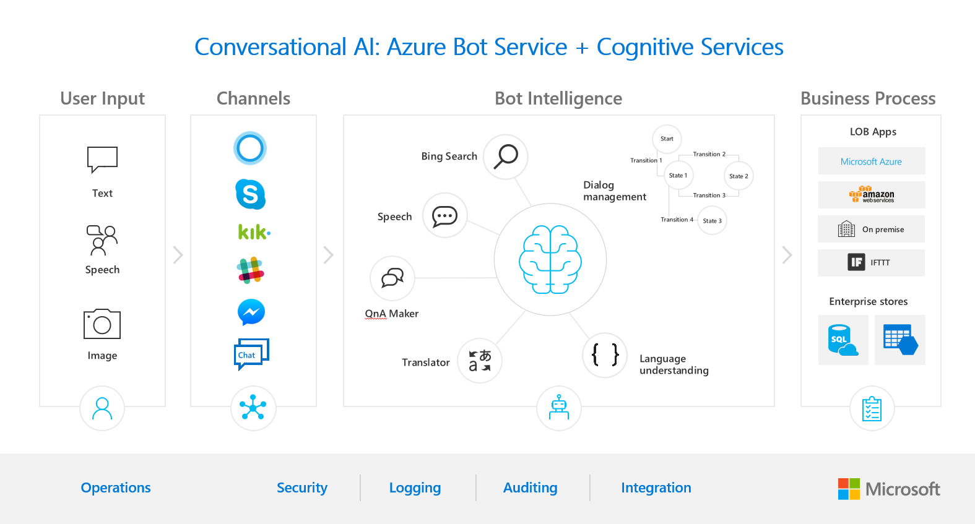

Slide 12
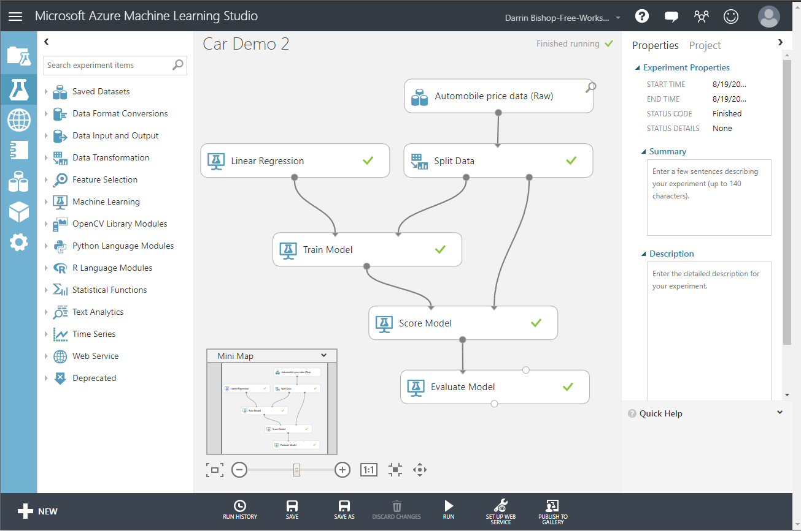
Microsoft Azure Machine Learning Studio
Workbench
Experimentation service
Model management
Visual Studio Code Tools for AI
AI Toolkit for Azure IoT Edge
MMLSpark

Slide 13
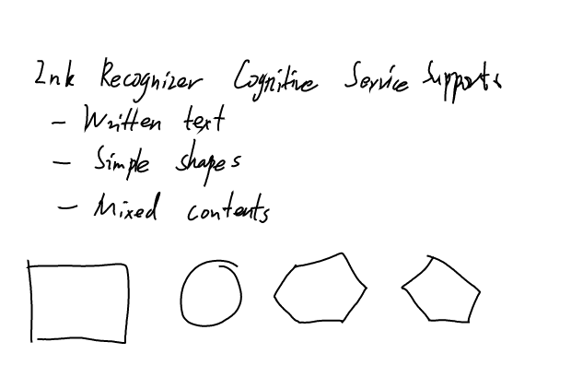
Demo
Ink Recognizer
Xamarin
Azure
SignaturePad

