Slide 1


Choose and manage a database for your Xamarin apps
Yiğit Özaksüt
@ozaksuty
yigit@ozaksut.com
www.ozaksut.com

Slide 2



SQLite3
Realm
Firebase

Slide 3
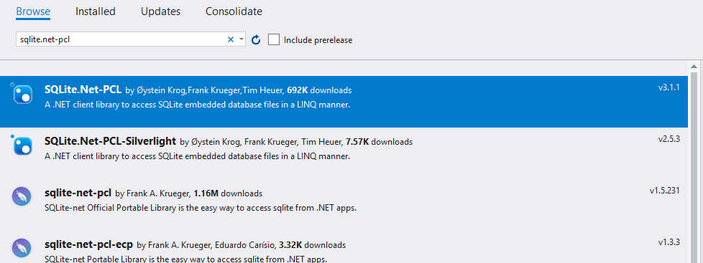
SQLite3 on Xamarin
https://github.com/oysteinkrog/SQLite.Net-PCL
Notes:
işlemsel ve ilişkisel bir SQL veritabanı motorudur.

Slide 4
DependencyService
public interface ISQLiteConnection
{
SQLiteConnection GetConnection();
}

Slide 5
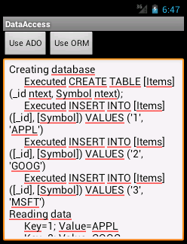
SQLite3 - Android
[assembly: Xamarin.Forms.Dependency(typeof(GetDroidConnection))]
namespace Ders4.Droid.ConnectionHelper
{
public class GetDroidConnection : ISQLiteConnection
{
public SQLiteConnection GetConnection()
{
string documentPath = System.Environment.GetFolderPath(System.
Environment.SpecialFolder.Personal);
var path = System.IO.Path.Combine(documentPath, App.DbName);
var platform = new SQLitePlatformAndroid();
var connection = new SQLiteConnection(platform, path);
return connection;
}
}
}

Slide 6
SQLite3 - iOS
[assembly: Xamarin.Forms.Dependency(typeof(GetiOSConnection))]
namespace Ders4.iOS.ConnectionHelper
{
public class GetiOSConnection : ISQLiteConnection
{
public SQLiteConnection GetConnection()
{
var documentPath = System.Environment.GetFolderPath(System.Environment.SpecialFolder.Personal);
var path = System.IO.Path.Combine(documentPath, App.DbName);
var platform = new SQLitePlatformIOS();
var connection = new SQLiteConnection(platform, path);
return connection;
}
}
}

Slide 7
SQLiteManager
SQLiteConnection _sqlconnection;
public SQLiteManager()
{
_sqlconnection = DependencyService.Get<ISQLiteConnection>().GetConnection();
_sqlconnection.CreateTable<Student>();
}
public int Insert(Student s)
{
return _sqlconnection.Insert(s);
}
public int Update(Student s)
{
return _sqlconnection.Update(s);
}
public int Delete(int Id)
{
return _sqlconnection.Delete<Student>(Id);
}
public IEnumerable<Student> GetAll()
{
return _sqlconnection.Table<Student>();
}
public Student Get(int Id)
{
return _sqlconnection.Table<Student>().Where(x => x.Id == Id).FirstOrDefault();
}

Slide 8
CRUD
private void onInsert(object sender, EventArgs e)
{
SQLiteManager manager = new SQLiteManager();
Student _student = new Student();
_student.Name = txtName.Text;
_student.Surname = txtSurname.Text;
int result = manager.Insert(_student);
if (result > 0)
{
DisplayAlert("BAŞARILI", _student.Name + " eklendi.", "OK");
}
else
{
DisplayAlert("BAŞARISIZ", _student.Name + " eklenemedi.", "OK");
}
}

Slide 9
SQLite3
SQLite3 is fast when you:
Use transaction properly
Access SQLite3 on a single thread
Prepare commands ahead of time
Make SQLite3 faster, the easy way
Connection.ExecuteScalar<int>("PRAGMA journal_mode=WAL");
Connection.Execute("PRAGMA temp_store=MEMORY");
Connection.Execute("PRAGMA synchronous=OFF");

Slide 10
Akavache
Added Bulk Operations
Bulk operations let us insert / lookup multiple keys at once
We can insert all of the keys in a single transaction
If one fails, we have to fail them all in a single transaction
https://github.com/reactiveui/Akavache
https://channel9.msdn.com/Events/Xamarin-Evolve/2016/Why-Akavache-is-Fast-How-Not-to-Use-SQLite
Notes:
paulcbetts

Slide 11
Realm
Offline first experiences
Event processing
Real-time 2 way data sync
API Mobilization
Presence
Messaging / Chat
Real-time Collaboration
Pub/Sub & Push Notification
In-App & Cross-App Search
IoT Sensor Sync
Endpoint Computing
Notes:
https://realm.io/docs/dotnet/latest

Slide 12
Firebase
Authentication
Database
Storage
Hosting
Functions
ML Kit
Notes:
https://realm.io/docs/dotnet/latest

