Slide 1


Azure AI & ML Tools
Yiğit Özaksüt
yigit@ozaksut.com
www.ozaksut.com

Slide 2
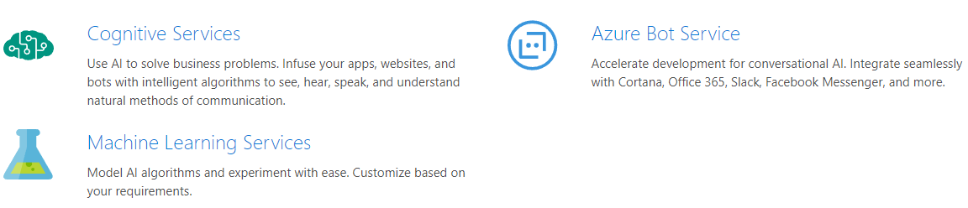
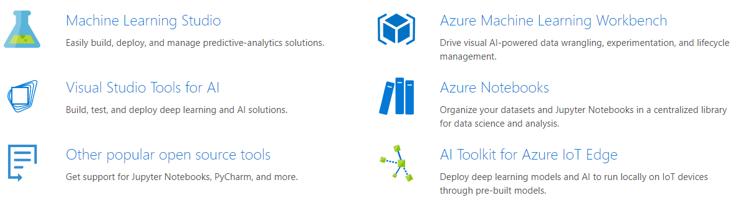
AI Services & Tools

Slide 3
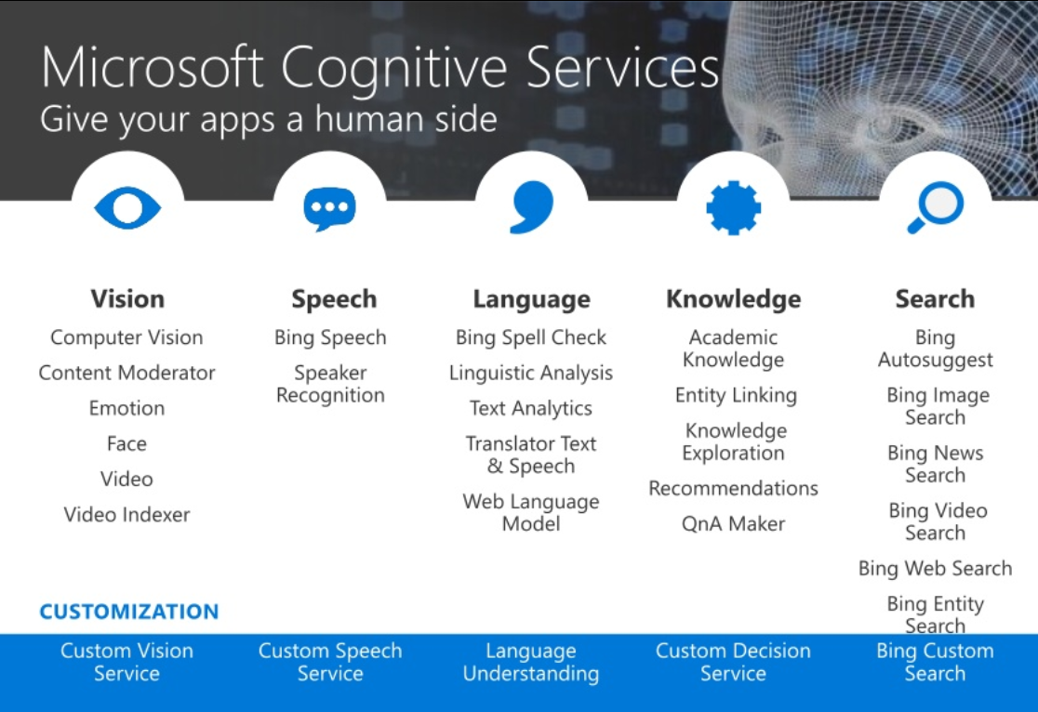
Use AI to solve business problems
Vision
Speech
Language
Knowledge
Search

Slide 4
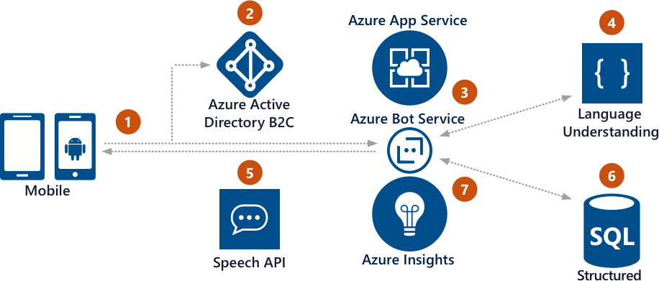
Give your bot intelligence with Cognitive Services

Slide 5
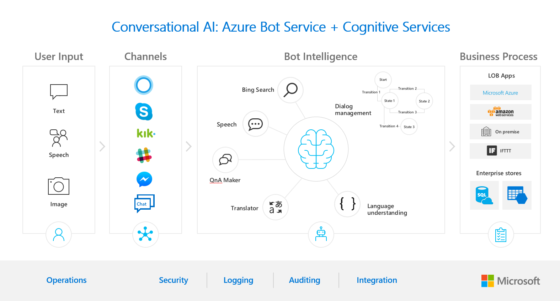

Slide 6
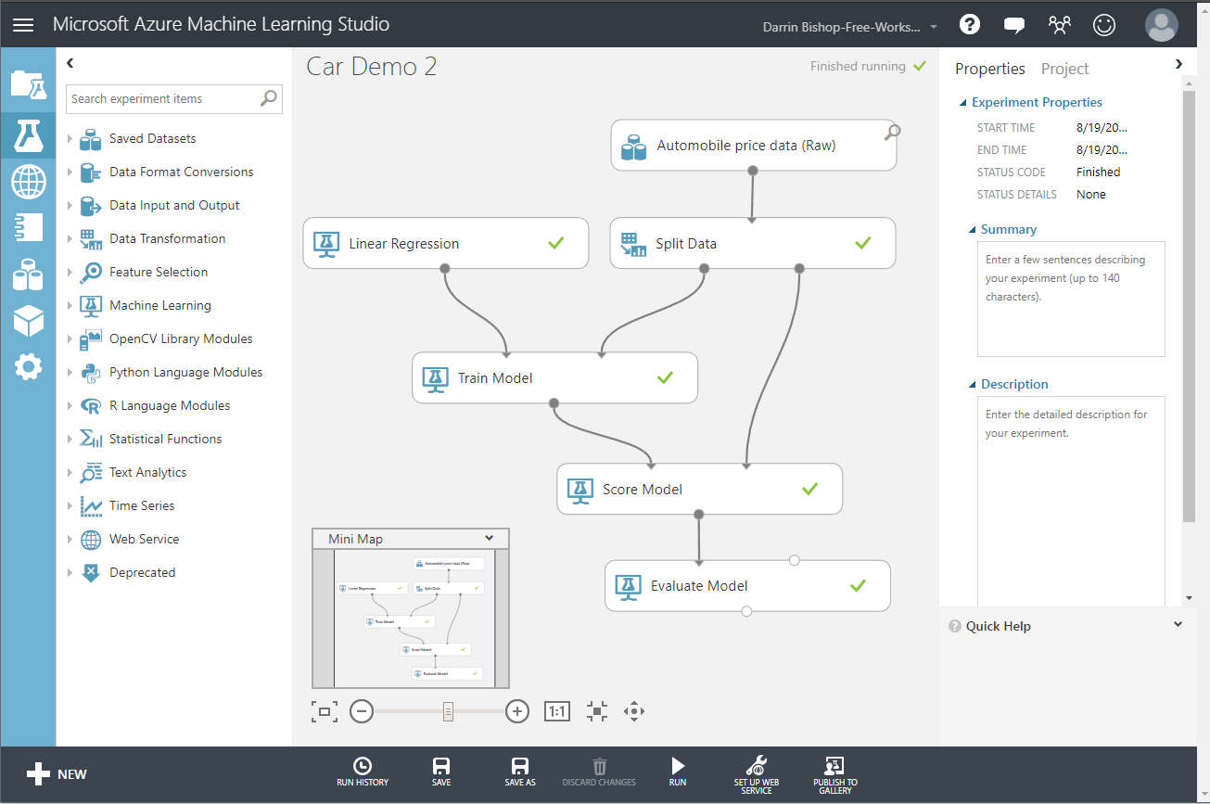
Microsoft Azure Machine Learning Studio
Workbench
Experimentation service
Model management
Visual Studio Code Tools for AI
AI Toolkit for Azure IoT Edge
MMLSpark

