Slide 1
Visual Studio App Center
Yiğit Özaksüt
yigit@ozaksut.com
www.ozaksut.com

Slide 2
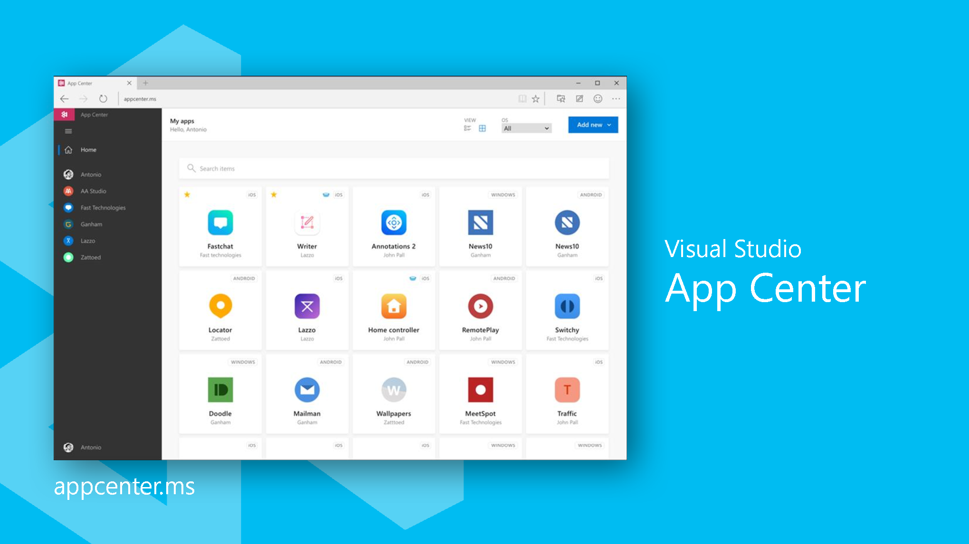
Agenda
Intro to App Center
Overview of Services
Demo
Resources

Slide 3
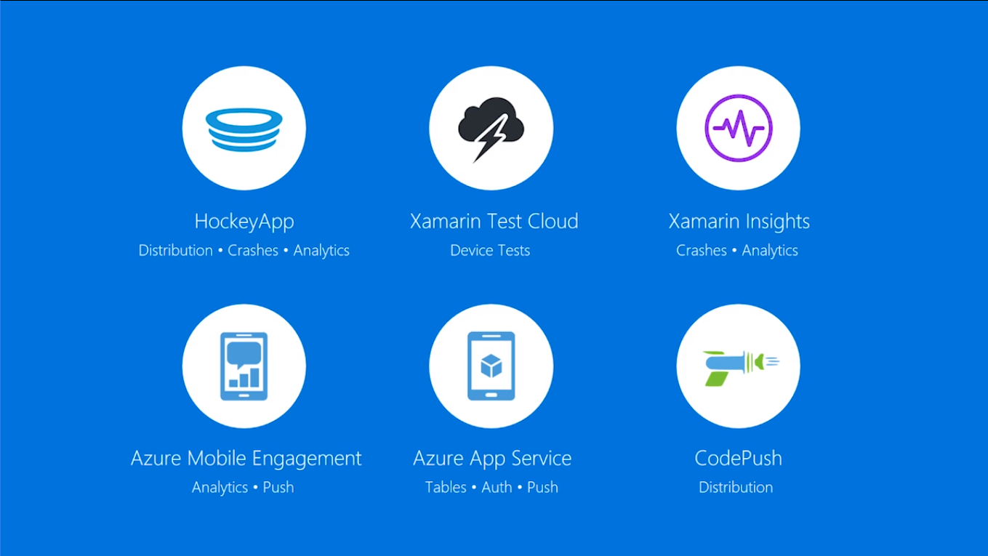
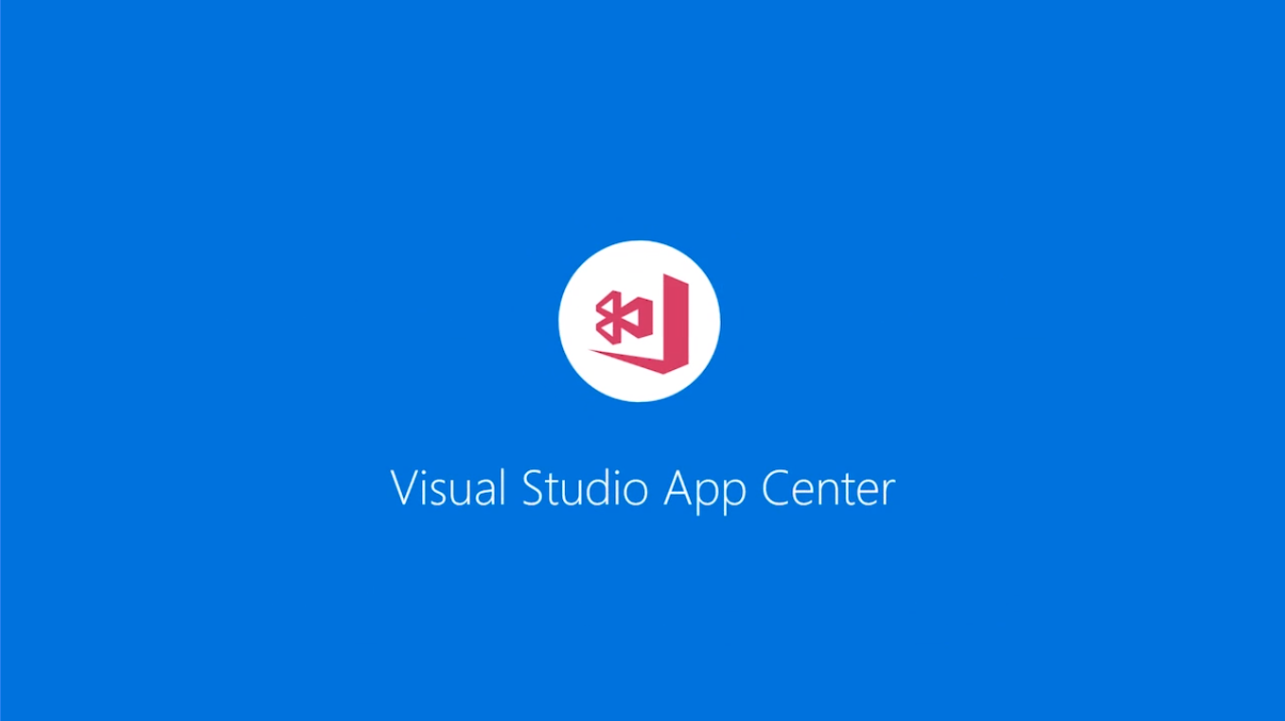

Slide 4
Platforms
Android
iOS
UWP
macOS
Java
Objective C / Swift
Xamarin
React Native
Cordova

Slide 5
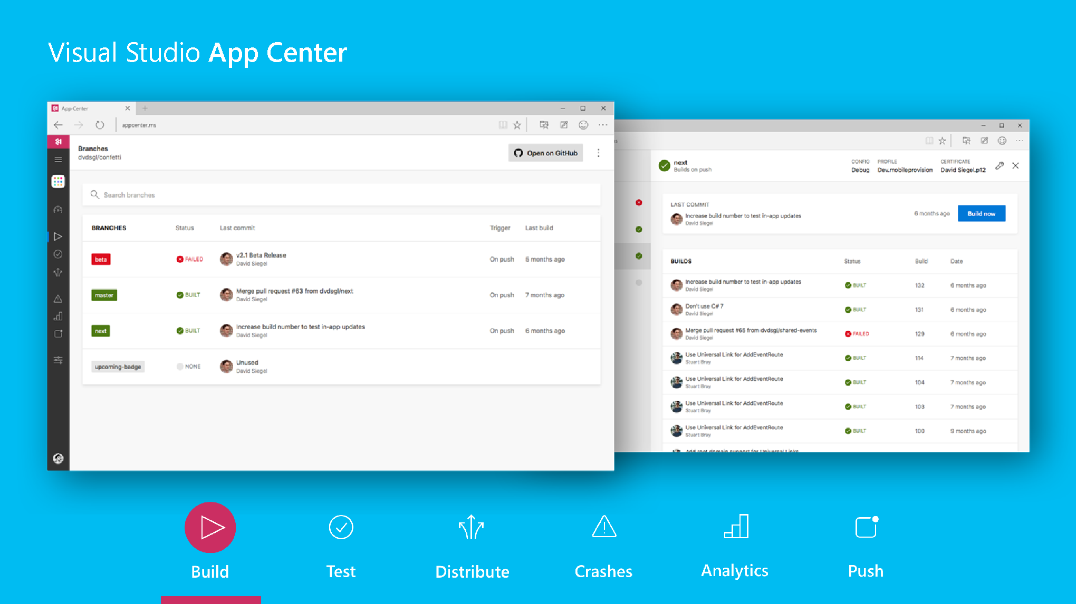
Build
VSTS
Github
BitBucket
Build in the Cloud

Slide 6
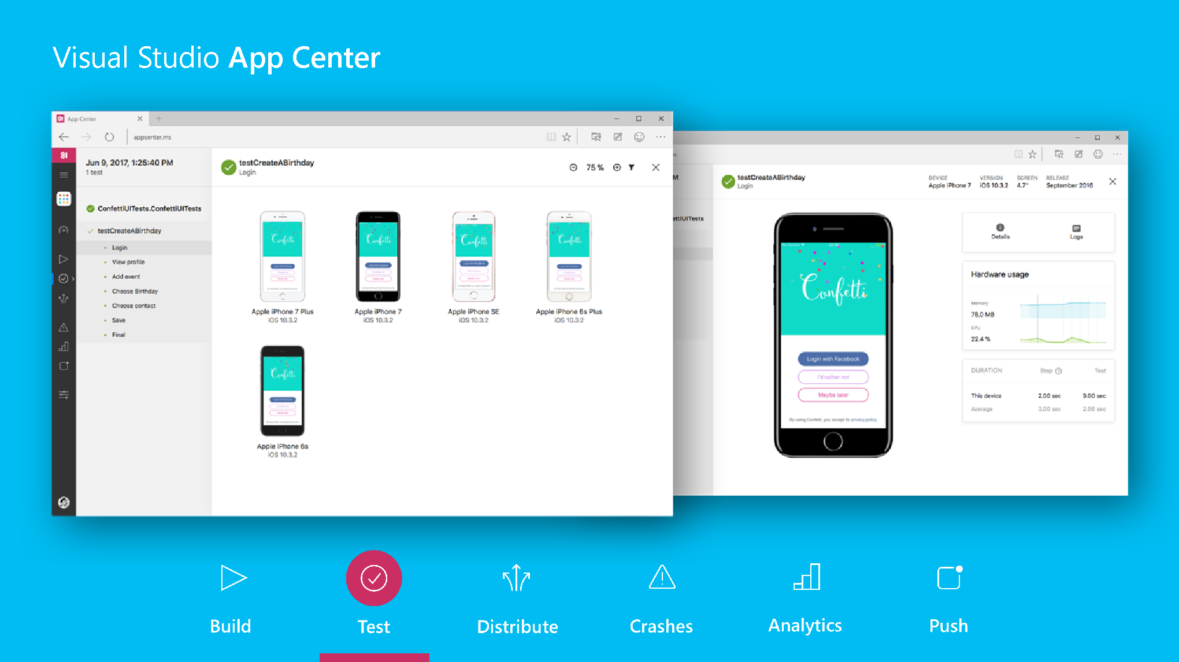
Test
Release Faster
Device Support
Appium
Espresso
Calabash
Xamarin.UITest

Slide 7
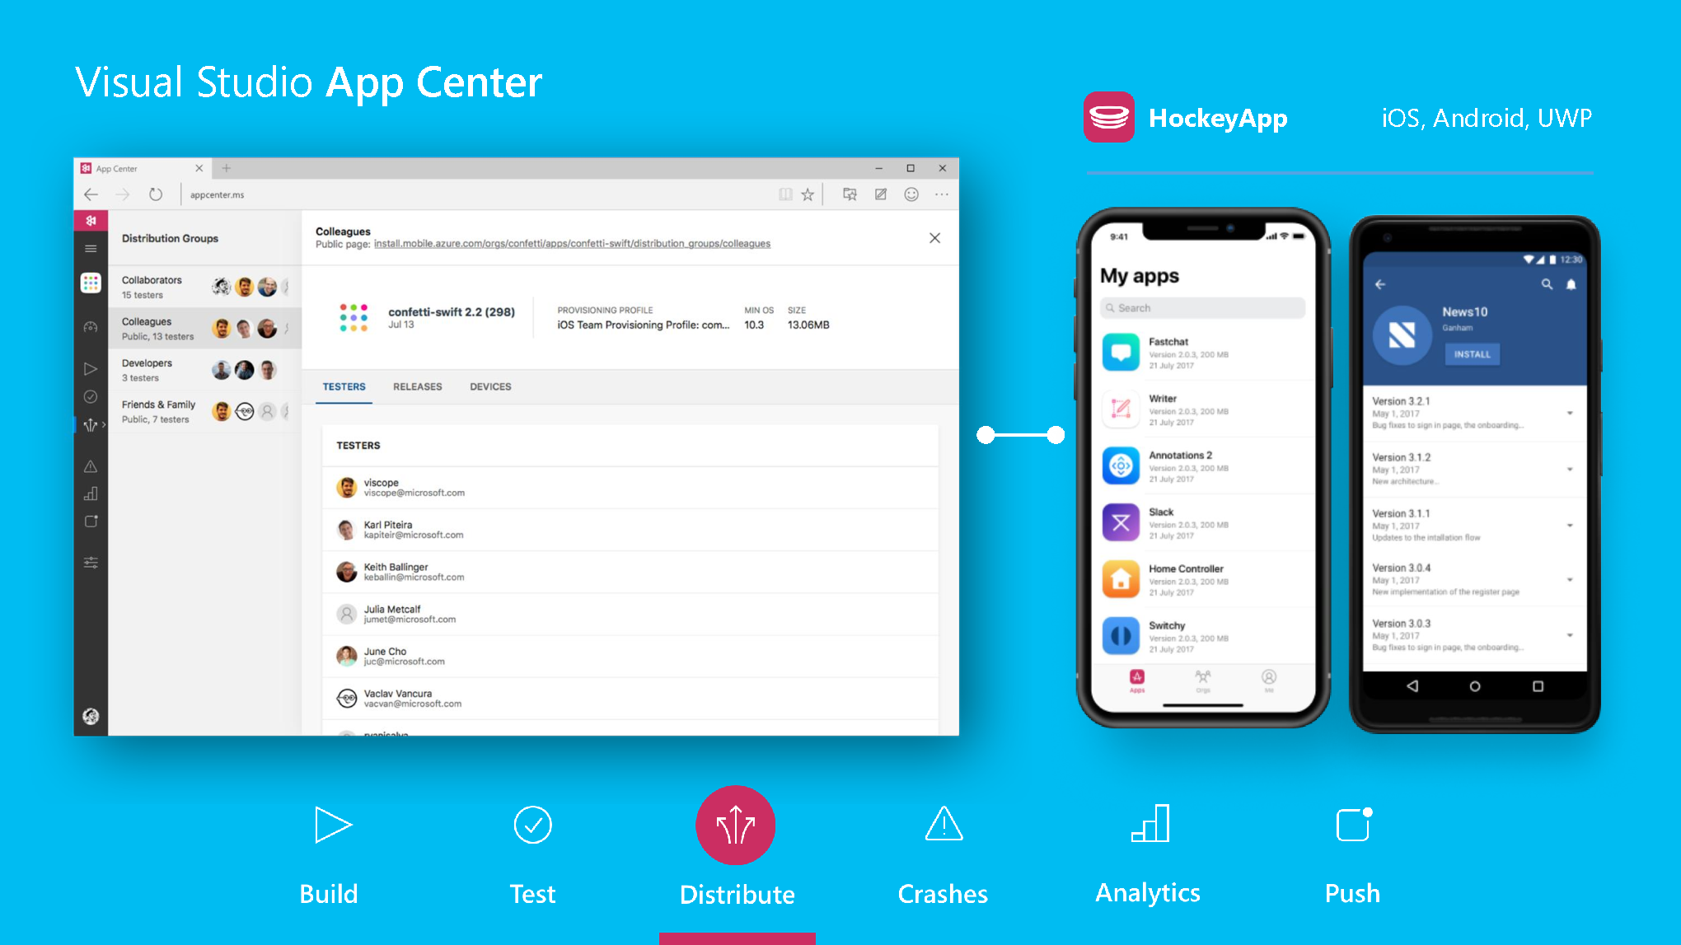
Distribute
Instantly Distribute Apps
Create Targeted Distribution Groups
Send in-App Updated
Publish Directly to Stores

Slide 8
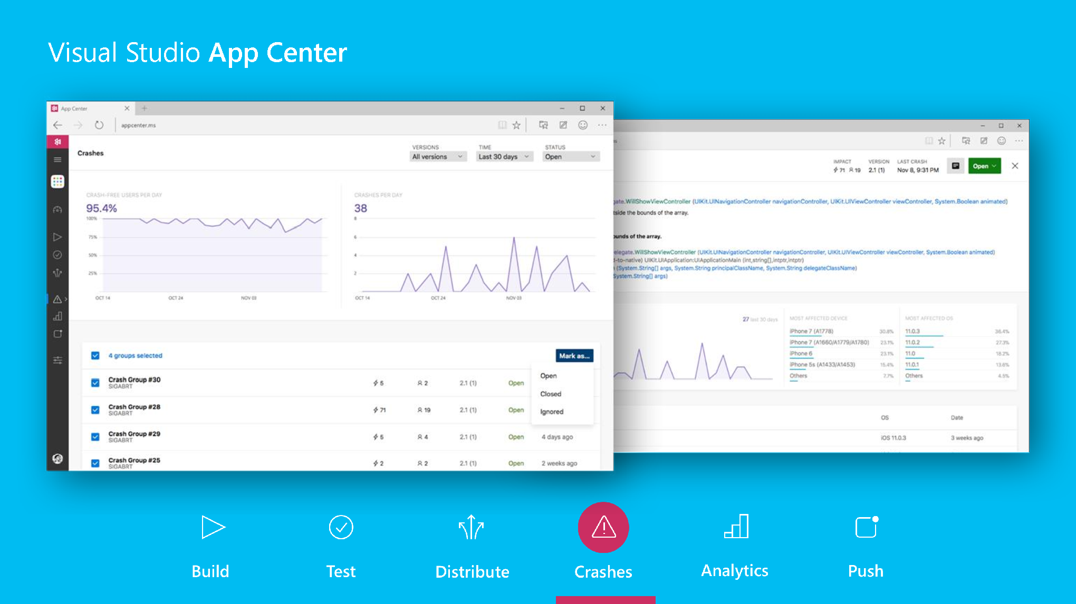
Crashes
Real Time insights
Easily analyze the data
Know your app healt

Slide 9
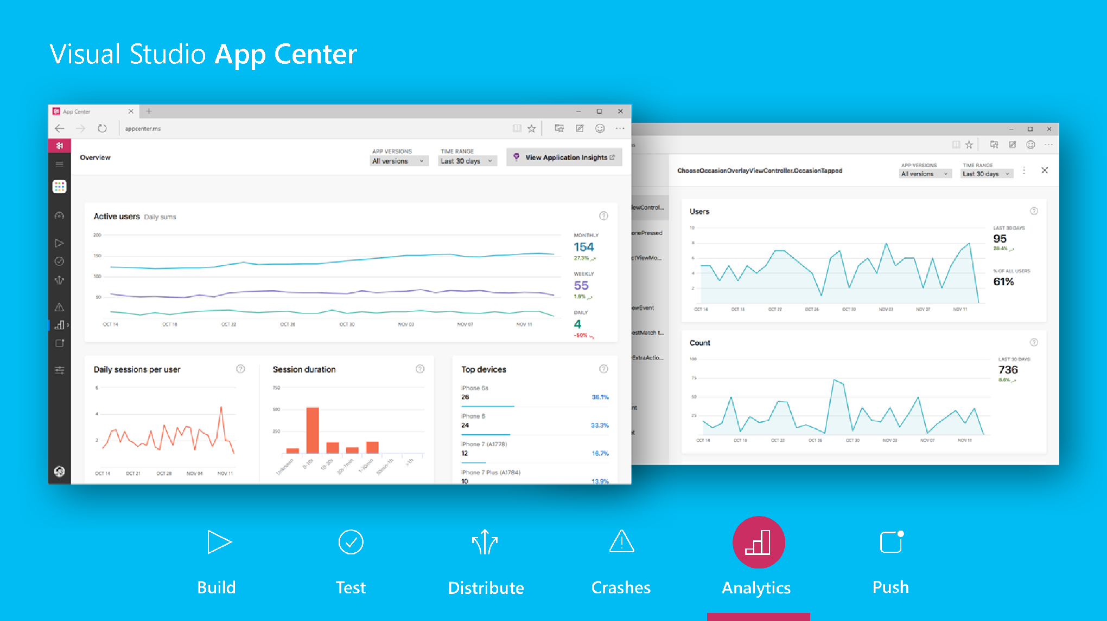
Analytics
Understand your customers
Log custom events
Active users
Daily session per user
Session duration
Top devices
Countries
Languages
Active user per version

Slide 10
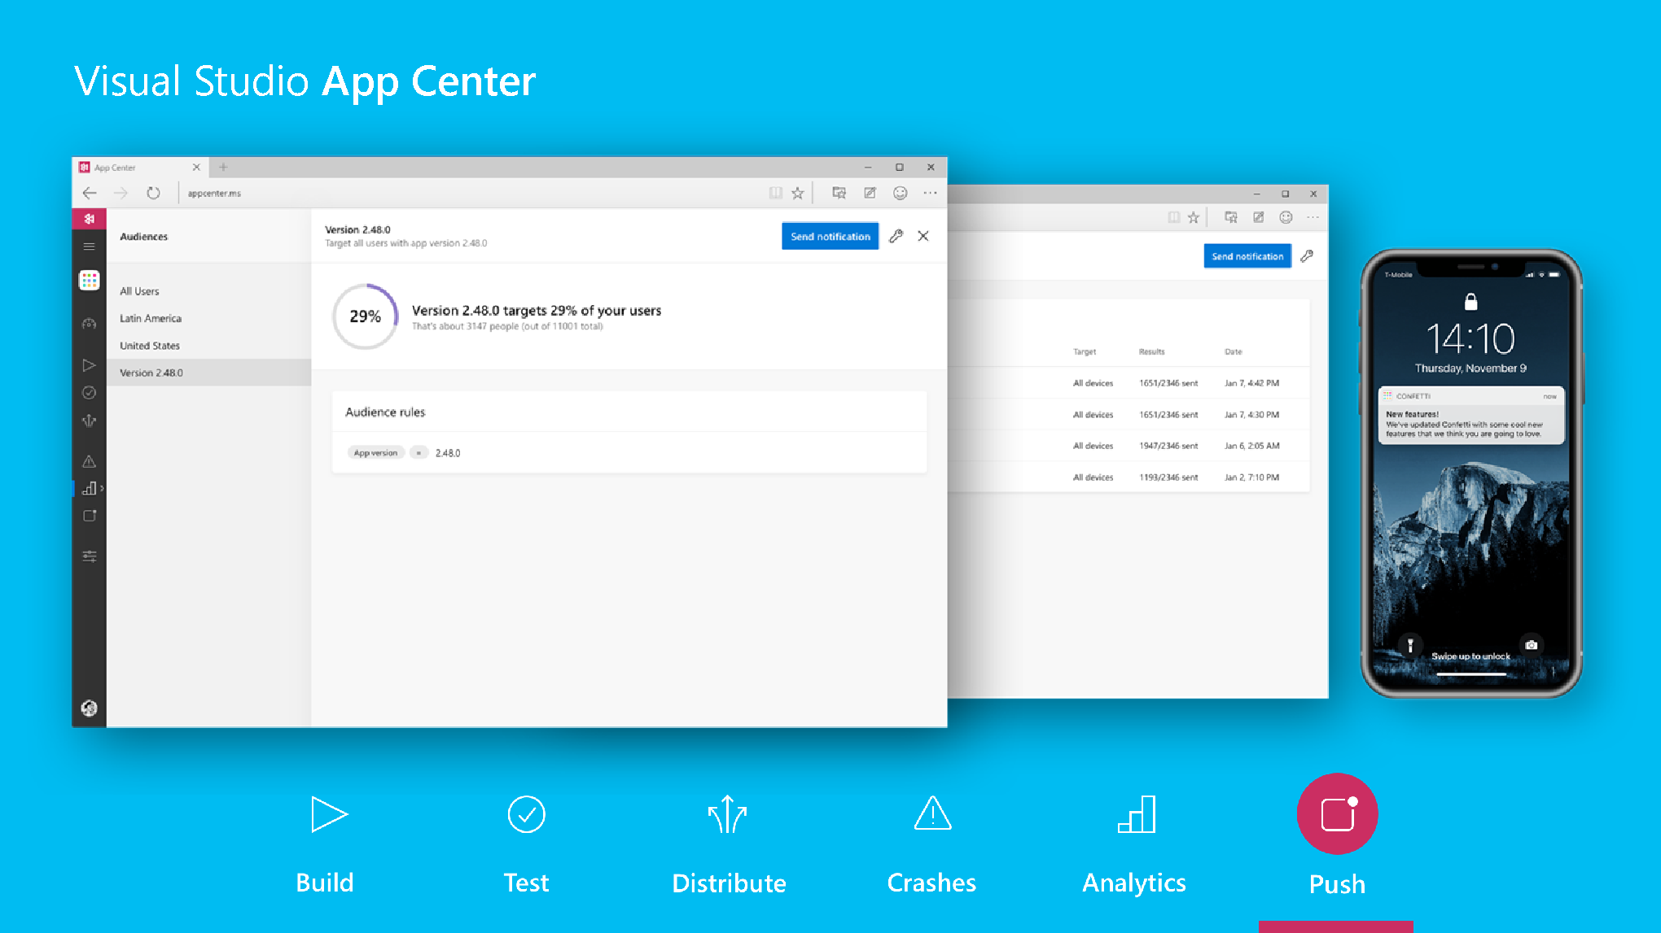
Push
Single source for push notifications
Create targeted messaging
Connect directly with users

Slide 11
Demo
https://docs.microsoft.com/en-us/appcenter/

